Slide 1
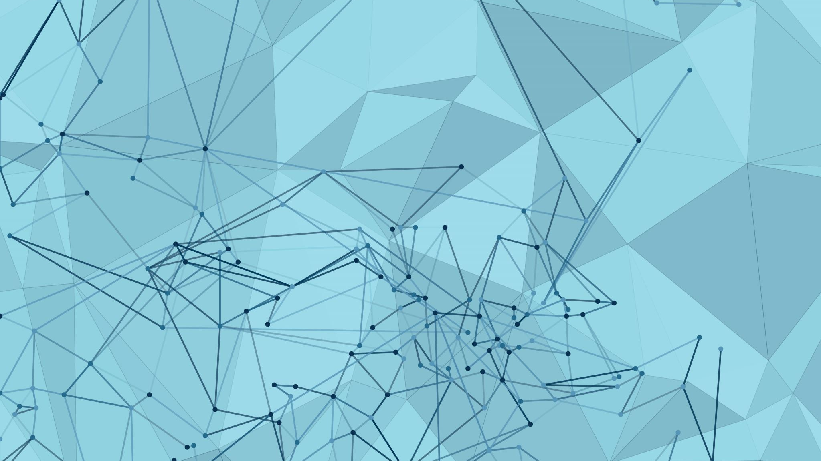

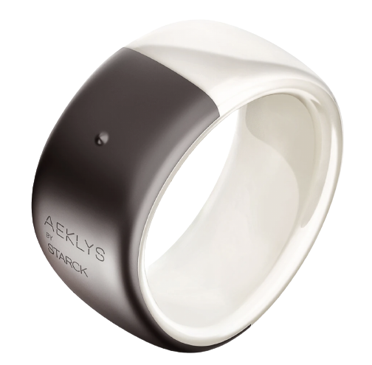
The futur of the ring

Slide 2

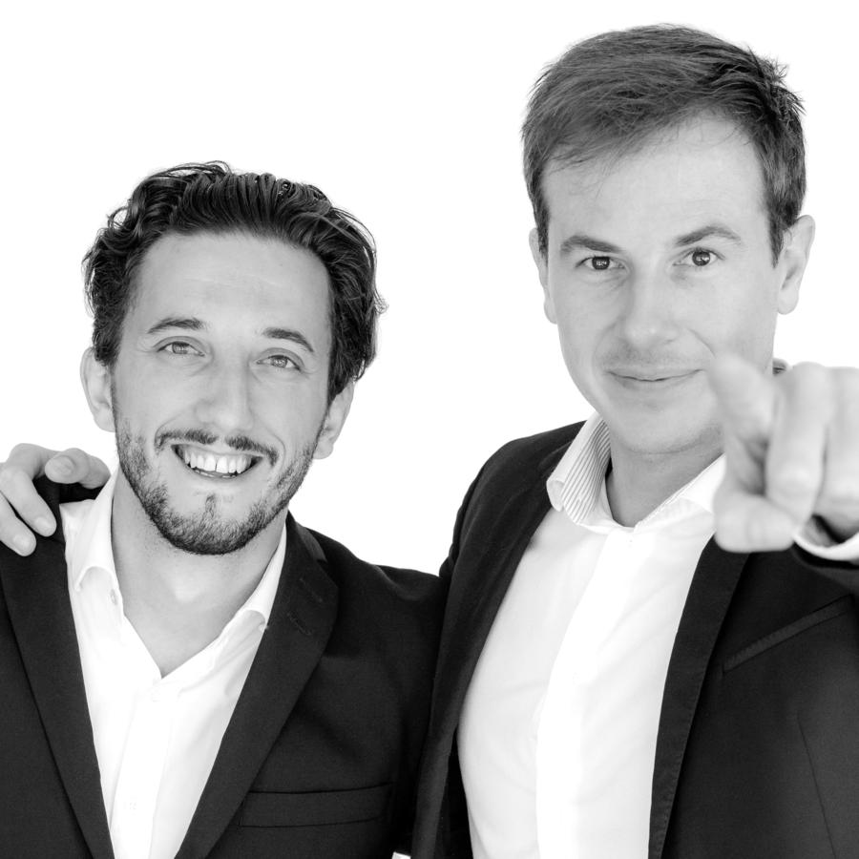
I/ The origins of the ring
t
Jeremy Neyron & Fabien Raiola
Founder of ICARE Technologies

Slide 3
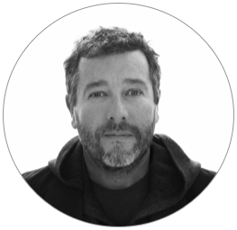

I/ The origins of the ring
Jeremy Neyron & Fabien Raiola
Philippe Starck
Founder of ICARE Technologies
Founder of STARCK

Slide 4
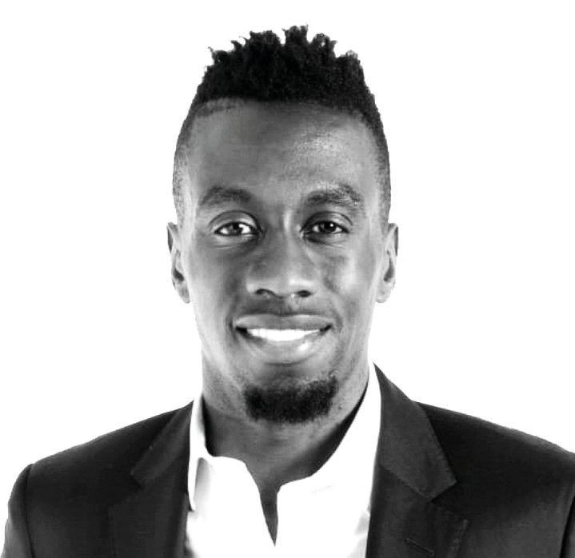
I/ The origins of the ring
Jeremy Neyron & Fabien Raiola
Philippe Starck
Founder of ICARE Technologies
Founder of STARCK
Blaise Matuidi
Principal Ambassador

Slide 5
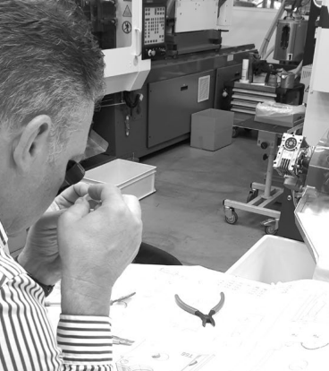
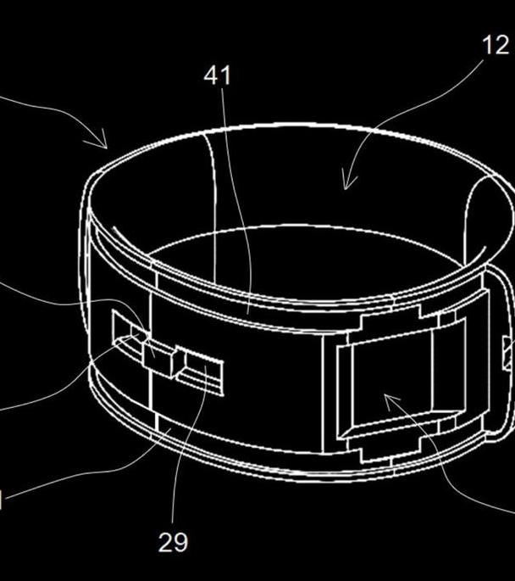
II/ How it’s possible ?

Slide 6
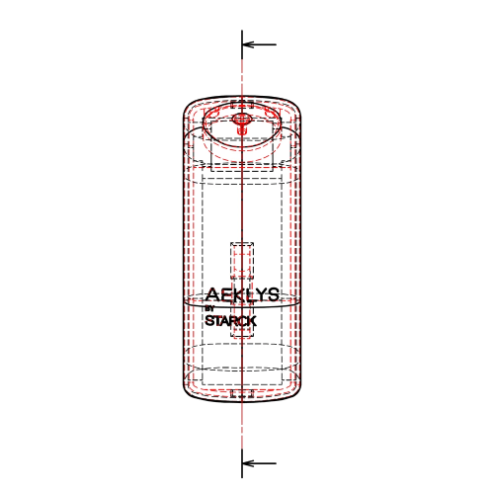
II/ How it’s possible ?
- 25 International patents
- 5 Years of Research & Development
- Multiply test in laboratory
- …

Slide 7
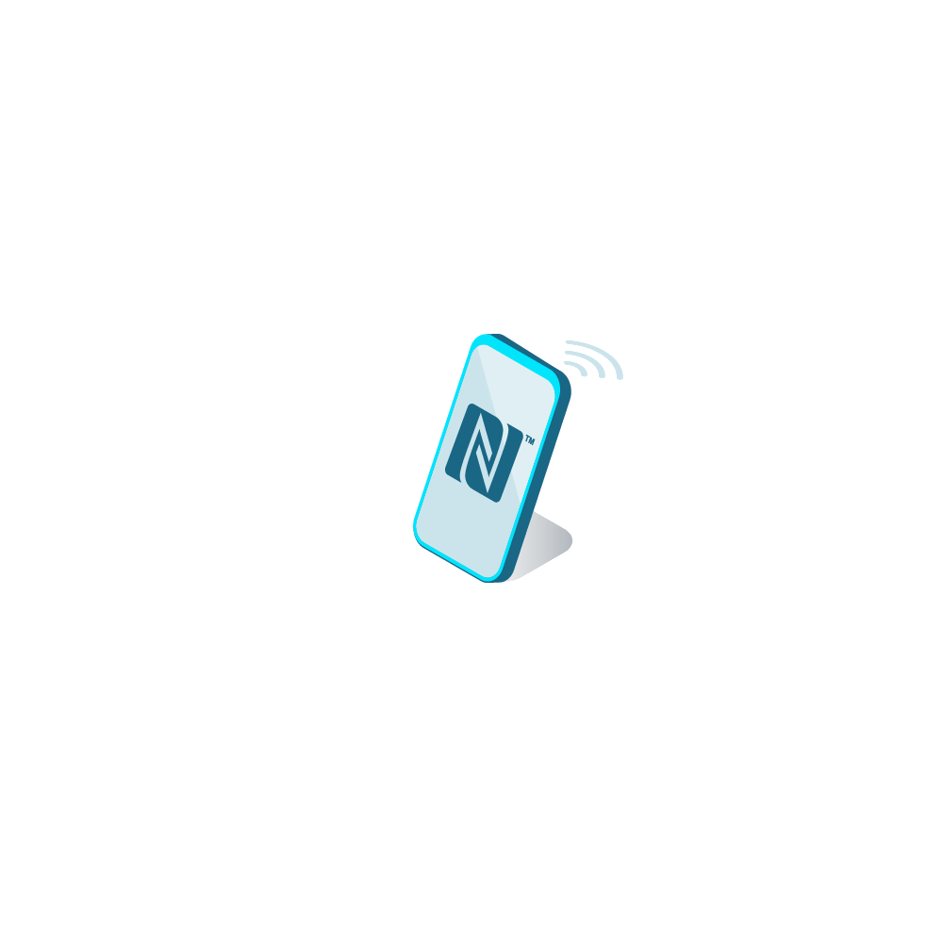
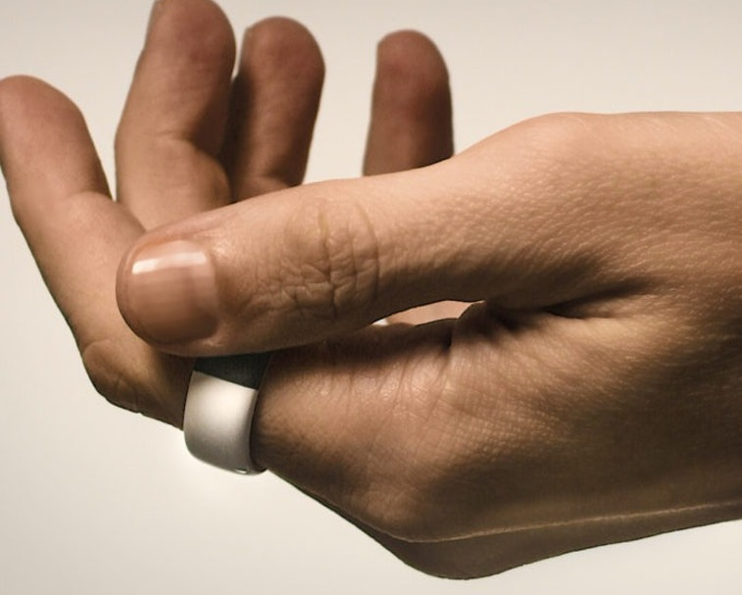
II/ How it’s possible ?
The Wave Control sensor
The N.F.C

Slide 8
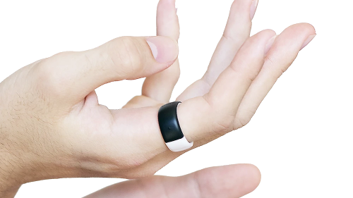
III/ The features of the ring

Slide 9

III/ The features of the ring
« Une bague connectée ?! – Aeklys by Starck » Romain Lanery - https://www.youtube.com/watch?v=EZnyEdDEbzI&t=169s

Slide 10
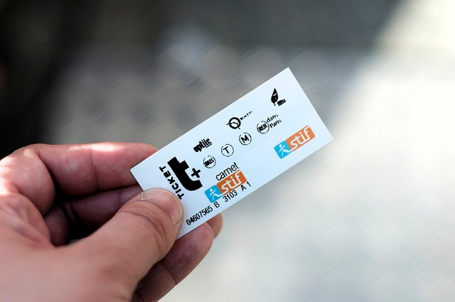
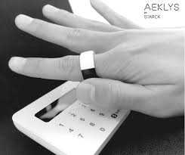
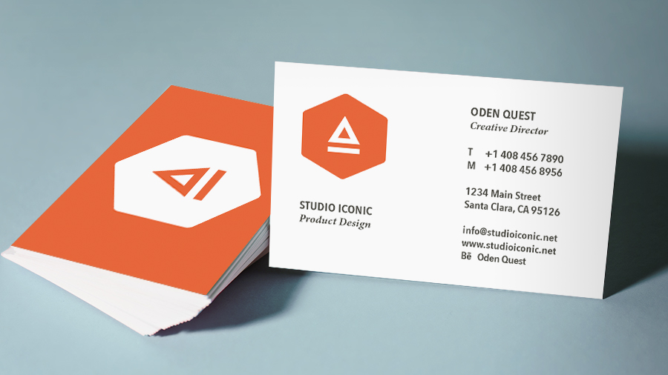
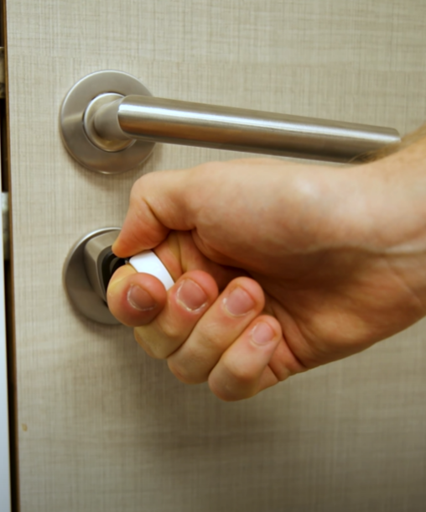
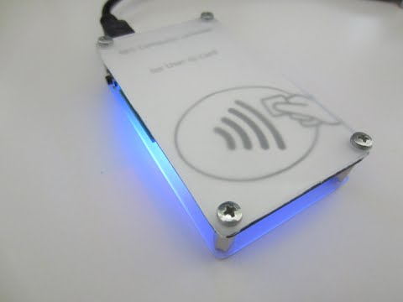
III/ The features of the ring
Have digital visited card
Paid in no contact
Use the public transport without paper ticket
Unlock you’re P.C.
Open doors
…………

Slide 11
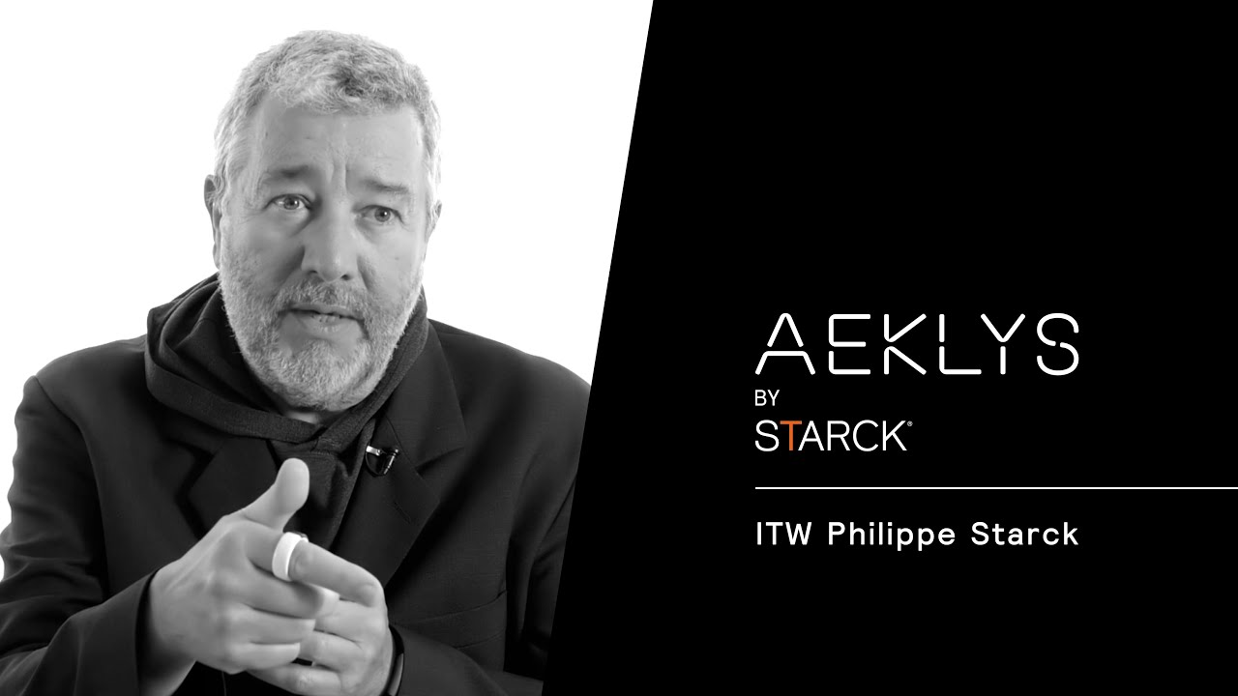
IV/ Conclusion
https://aeklys.com/

